Slide 1
PEP 559 Machine Learning in Quantum Physics
Dr. Chunlei Qu

Slide 2
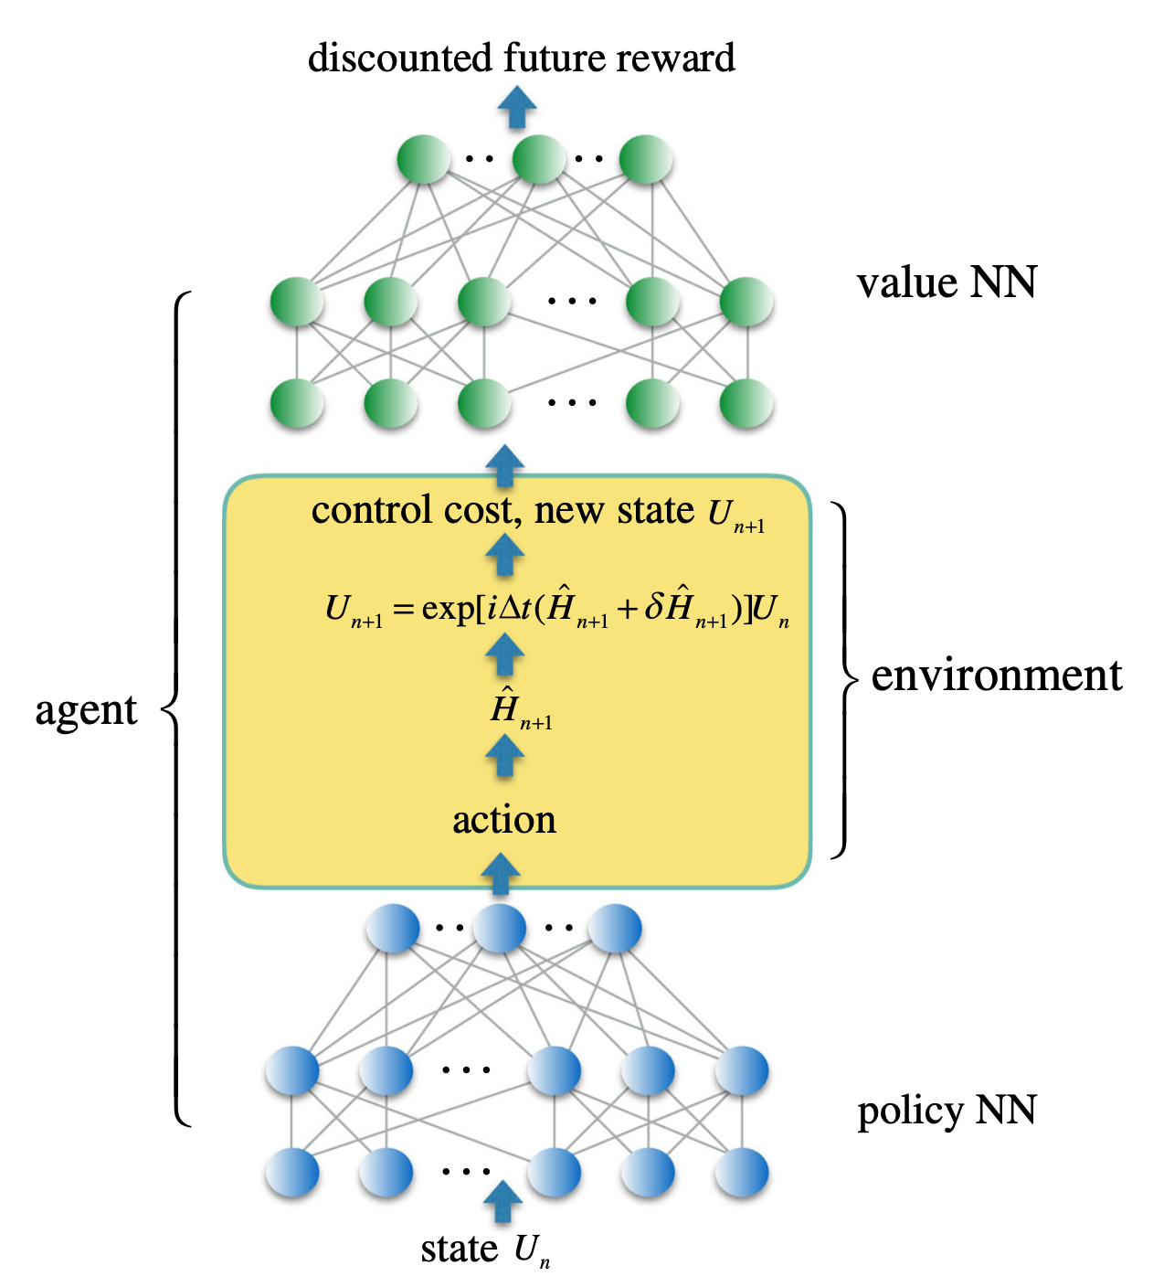
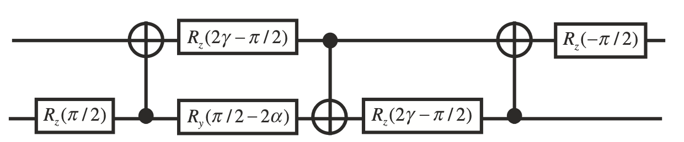
Reinforcement learning for quantum computing (quantum control optimization)
A quantum circuit
Depth: 7
Three two-qubit gates
Five single qubit gates
To realize a unitary transformation
How do we find the optimal parameters to realize such an operation with the above circuit?

Slide 3
Outline
I. Quantum computing (qubits, gates, circuits, etc)
II. Introduction to reinforcement learning
III. RL for quantum gate optimization

Slide 4
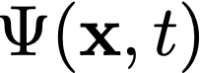
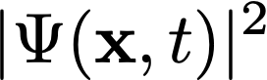
Amplitudes and Probabilities
Born’s Rule:
Quantum systems are described by complex wave functions (the probability amplitudes)
The probabilities of finding a particle at a point x is the absolute square of the wave function

Slide 5
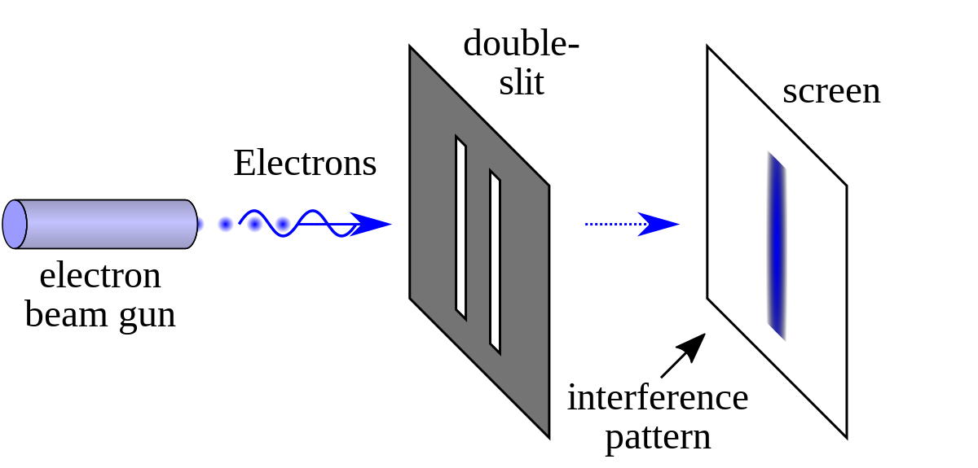
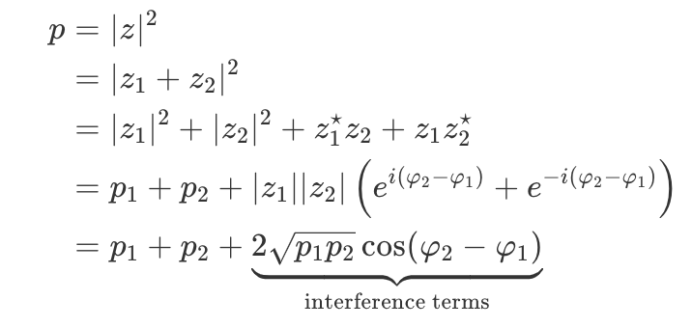
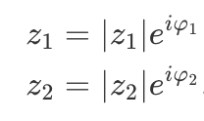
Quantum Interference The double-slit experiment
Since there are two paths, we first add the amplitudes, and then take the absolute square of the sum to find the probability
where
Originates from the addition of wave functions

Slide 6
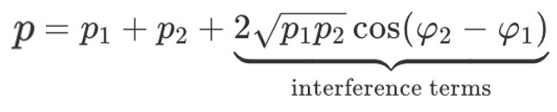
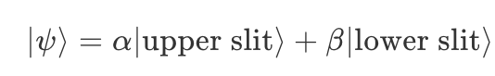
Quantum interference
Negative interference term → destructive interference
Positive interference term → constructive interference
Even for single quantum particle, we cannot say it has travelled through either the upper or the lower slit. It has travelled through both.
Quantum superposition (in terms of Dirac notations)

Slide 7
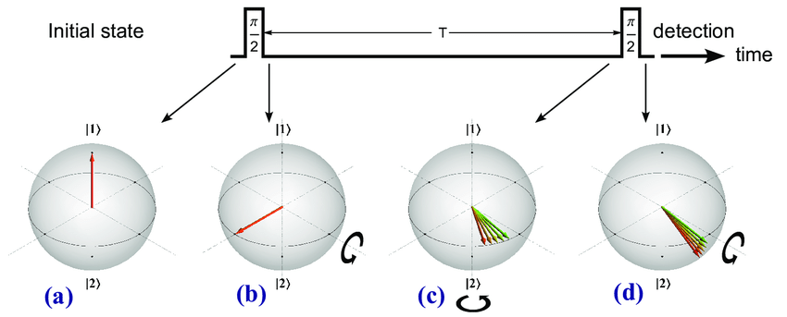
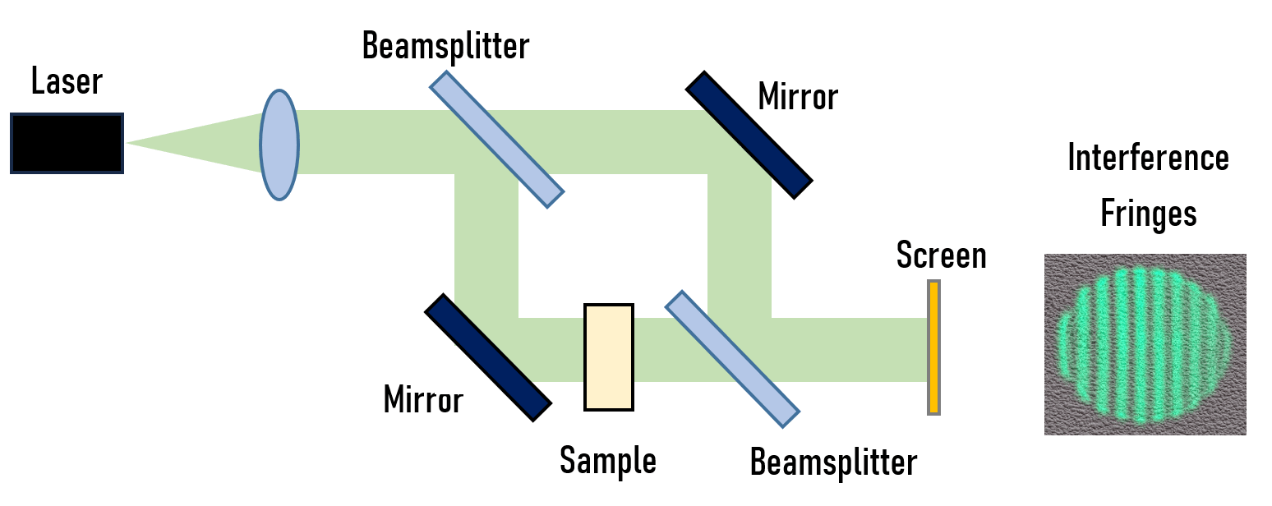
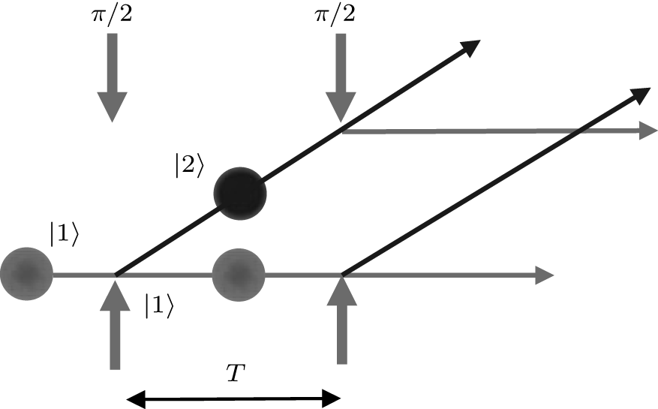
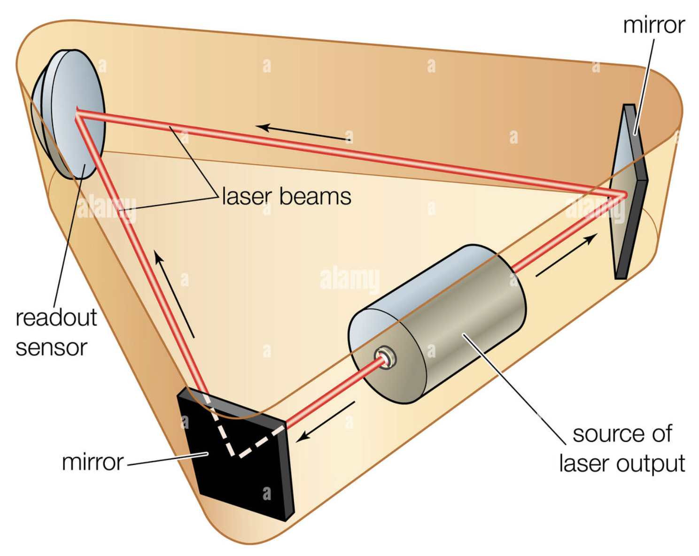
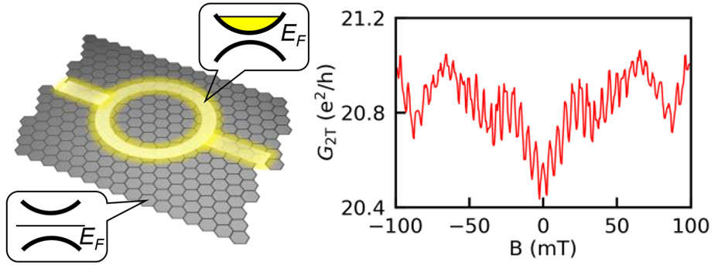
Quantum interferometer
Ramsey interferometry
Mach-Zehnder interferometry
Atom interferometry
Aharonov-Bohm interferometry
Ring laser gyroscope

Slide 8
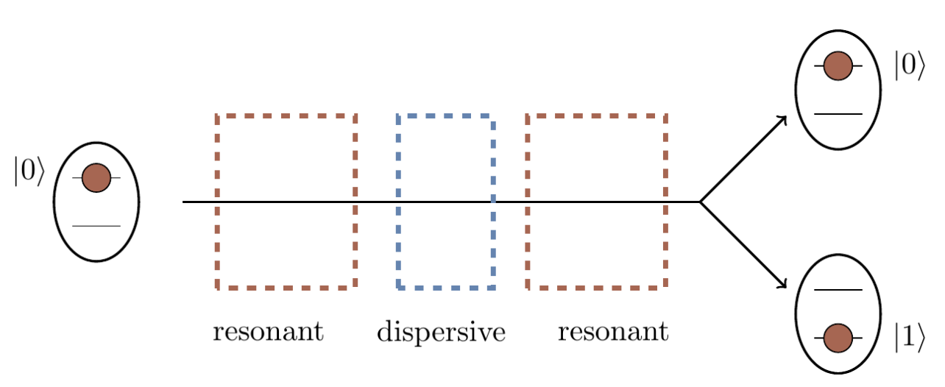
Ramsey interferometry
Step 1: Two-level atoms, initially prepared in |0>
Step 5: measure the population
Step 2: apply a resonant 𝜋/2-pulse of Rabi-coupling
Step 3: the atom acquires a phase shift (different phase accumulation for the two levels)
Step 4: apply a resonant 𝜋/2-pulse of Rabi-coupling

Slide 9
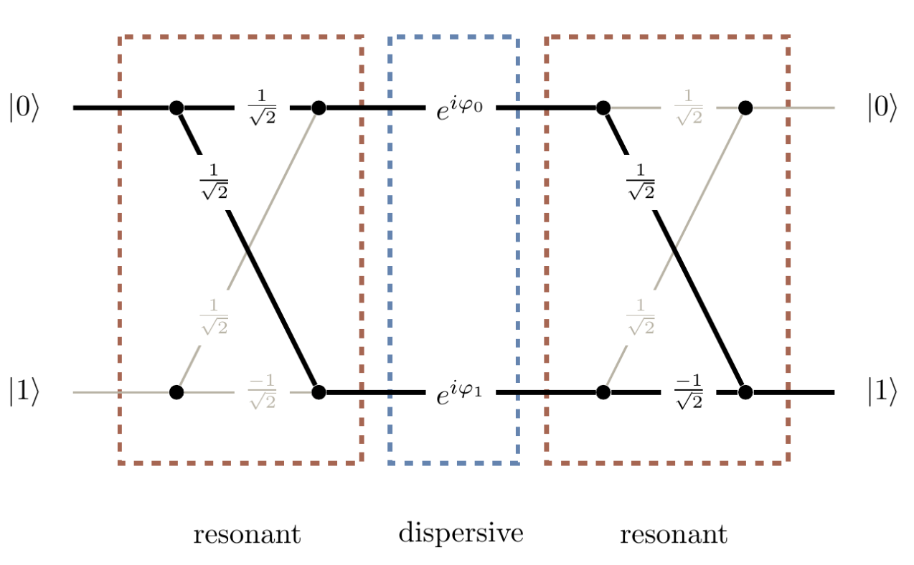
Ramsey interferometry
Similar to the two-slit experiment, there are two possible paths from left to right

Slide 10


Ramsey interferometry

Slide 11
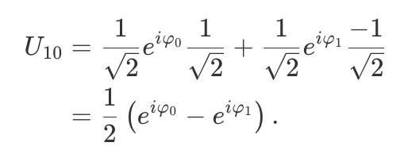
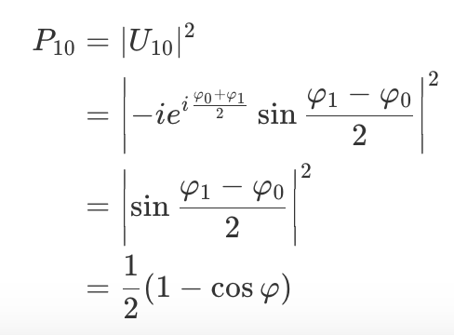
Initially in |0>
The amplitude to find the atom in |1> state will be
The corresponding probability will be
We can verify that the probability of finding the particle in |0> is
P₀₀=1-P₁₀

Slide 12
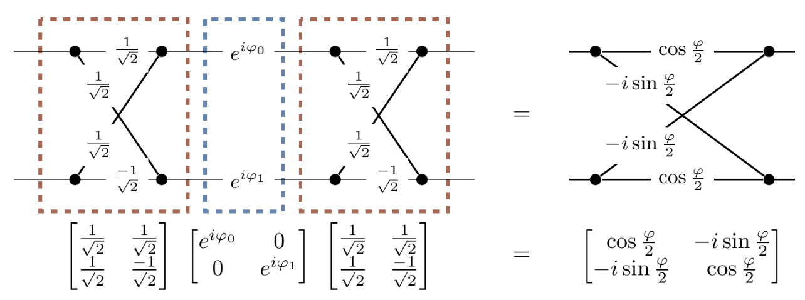
Matrix representation
Each part is like a device (a quantum operator that is represented as a matrix)
It acts on the initial state to get the final state

Slide 13
Quantum bits (qubits)
Two well defined quantum states
They can be coupled together, and they are isolated from other states
Such two-level quantum systems are called quantum bits, or qubits

Slide 14
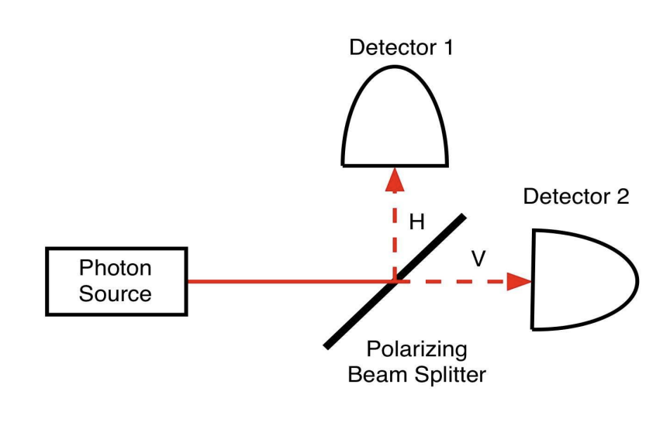
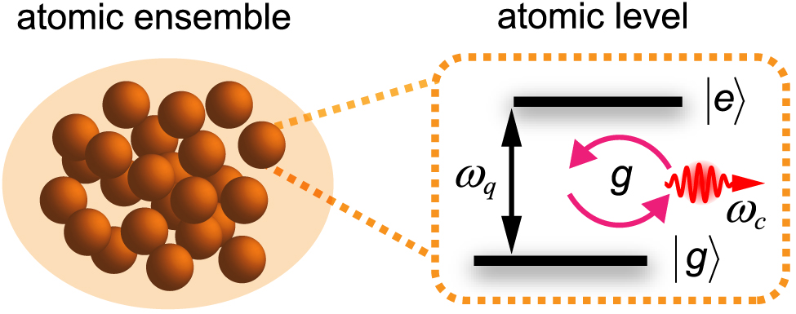
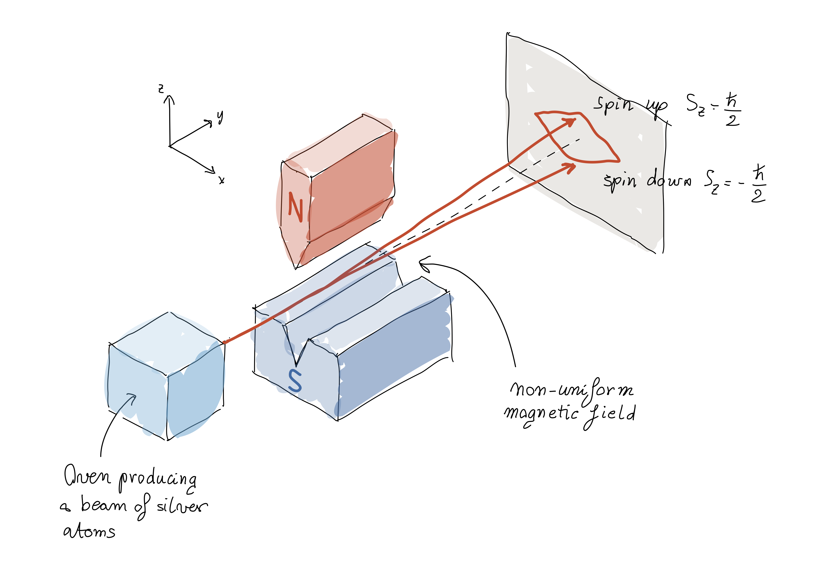
Examples of qubits
Internal states of atoms
Polarization of photons
Spin states of electrons

Slide 15
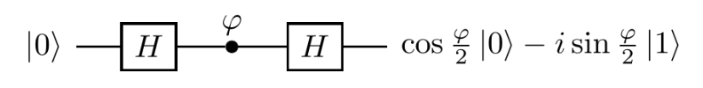
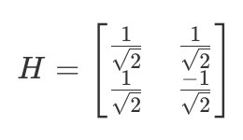
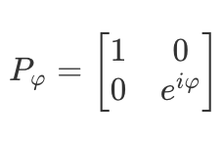
Quantum gates
Ramsey interferometry is to apply a series of quantum transformations or operations (quantum gates) on the qubit
Initial state |0>
Amplitude in |0> at the end of the circuit
Hadamard gates
Phase gate

Slide 16
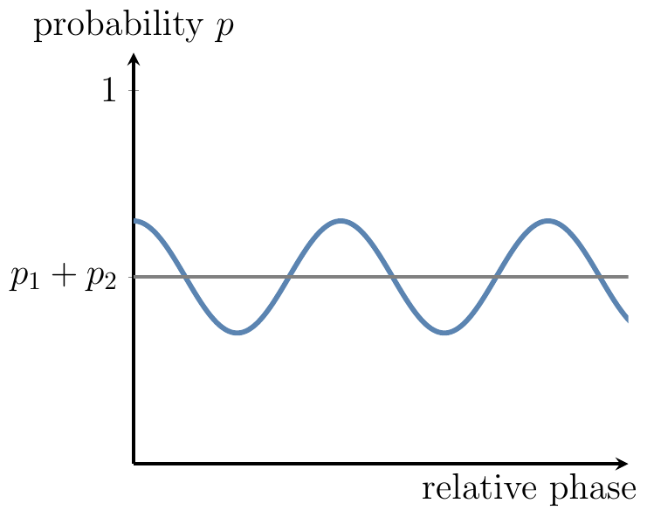
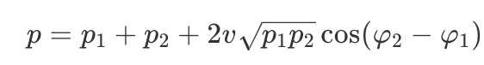
Quantum decoherence
We can hardly see quantum interference in the daily life. Why?
Perfect quantum oscillation only occurs in isolated quantum systems. Decoherence suppresses quantum interference.
v: visibility of the interference pattern
v=0: total decoherence
v=1: no decoherence (full interference)
0<v<1: partial decoherence

Slide 17
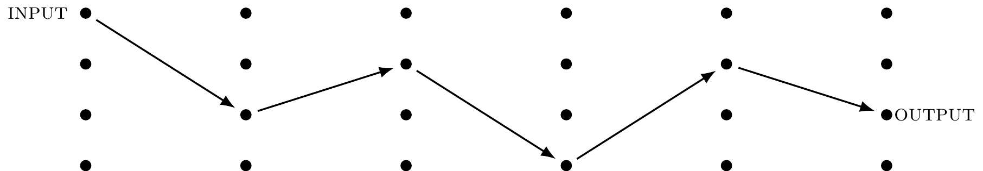
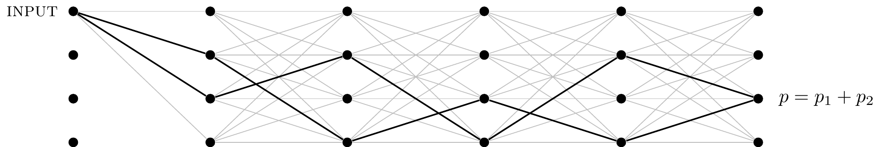
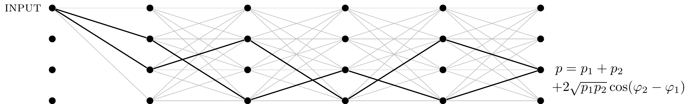
Computations
Deterministic computation
Probabilistic computation
e.g.,
Monte-Carlo
Quantum computation

Slide 18
Quantum computation
Quantum computation can be viewed as a complex multi-particle quantum interference involving many computational paths through a computing device.
The art of quantum computation is to shape the quantum interference through a sequence of computational steps, enhancing probabilities of the “correct” outputs and suppressing probabilities of the “wrong” ones.

Slide 19
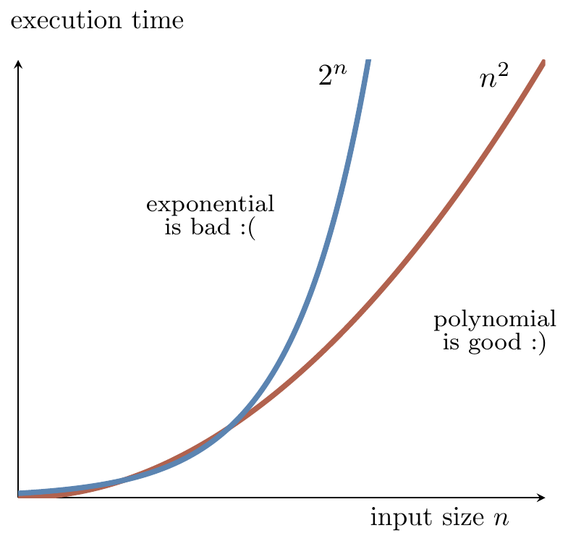
Computational complexity
In order to solve a particular problem, computers (classical or quantum) follow a precise set of instructions called an algorithm
An algorithm is said to be efficient if the number of elementary operations taken to execute it increases no faster than polynomial function of the size of the input
Number factoring with classical computer is exponential
Peter Shor showed that quantum computer can solve it with a computational time ~ n²

Slide 20
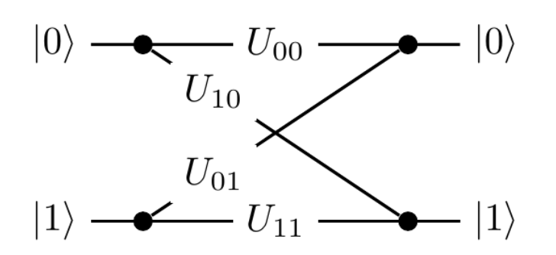
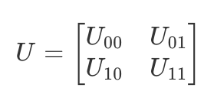
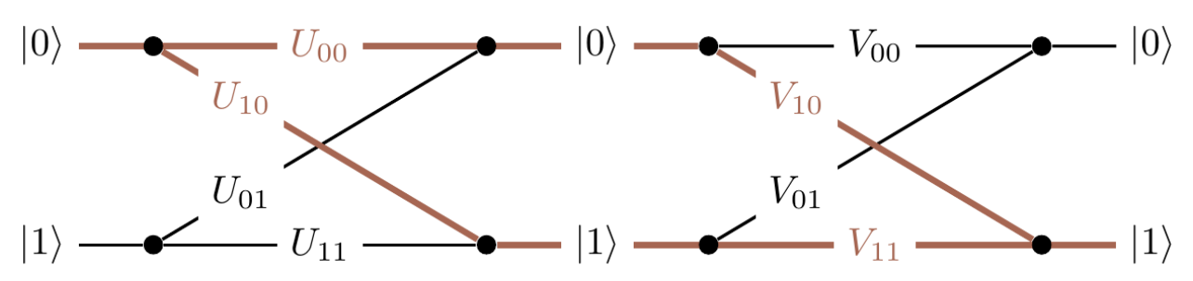
Unitary operations
Each computational step is to act a 2x2 unitary matrix on the qubit
The composition of two computational step

Slide 21
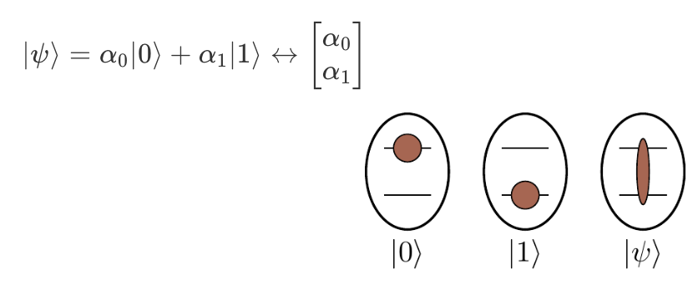
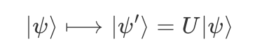
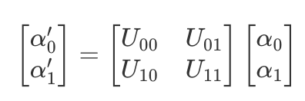
Abstract notations for Qubits and Quantum Gates

Slide 22
Quantum circuits
A quantum circuit is a device consisting of a series of quantum logic gates whose computational steps are synchronized in time
The size of a circuit is the number of gates it contains
The gates in a circuit can be divided into layers, where the gates in the same layer operate at the same time
The number of such layers is called the depth of a circuit

Slide 23
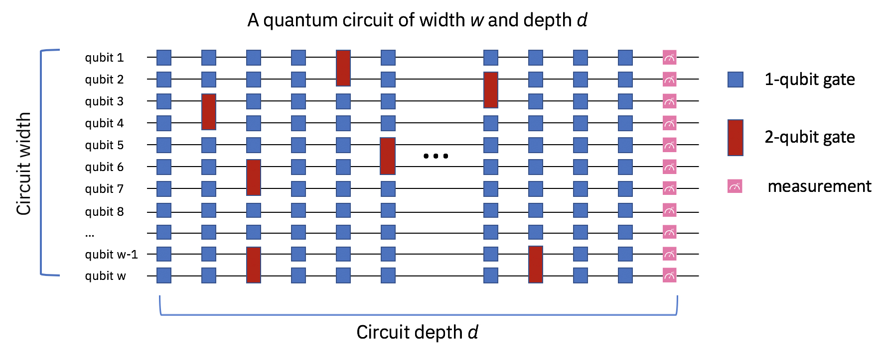
Quantum circuits

Slide 24
Some important quantum gates

Slide 25
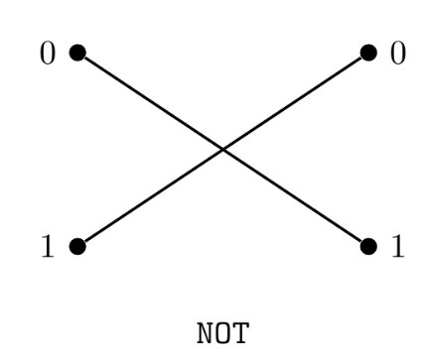
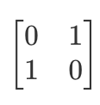
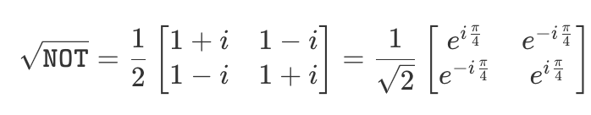
NOT and The square root of NOT
NOT gate
NOT =

Slide 26
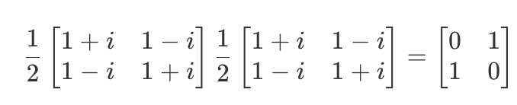
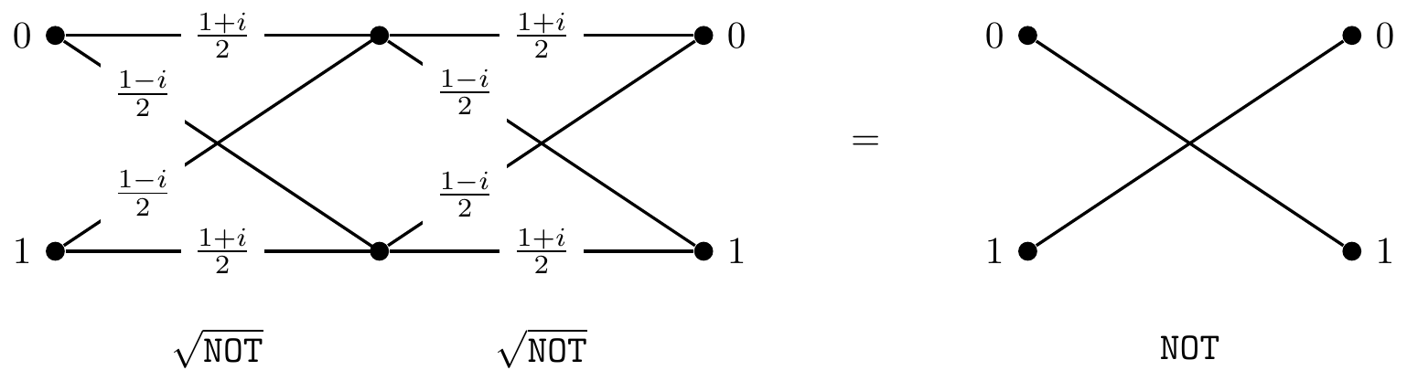
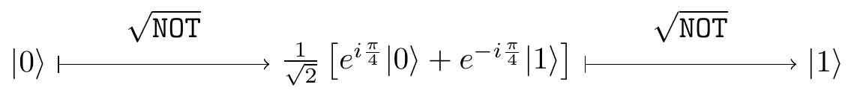
The square root of NOT
Check

Slide 27
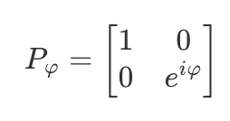
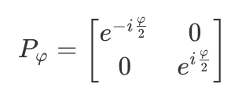
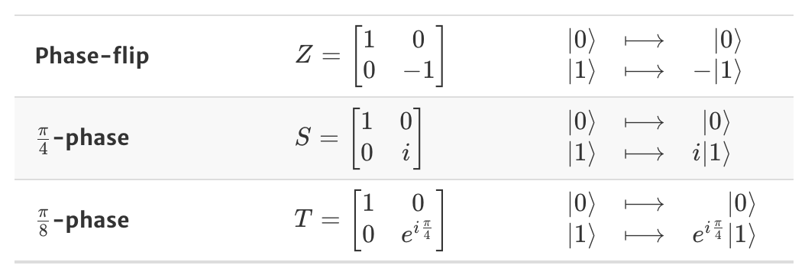
Phase gates
or
Global phase not important
More specifically, we may use the following phase gates
Sometimes it is also called Pauli-Z gate

Slide 28
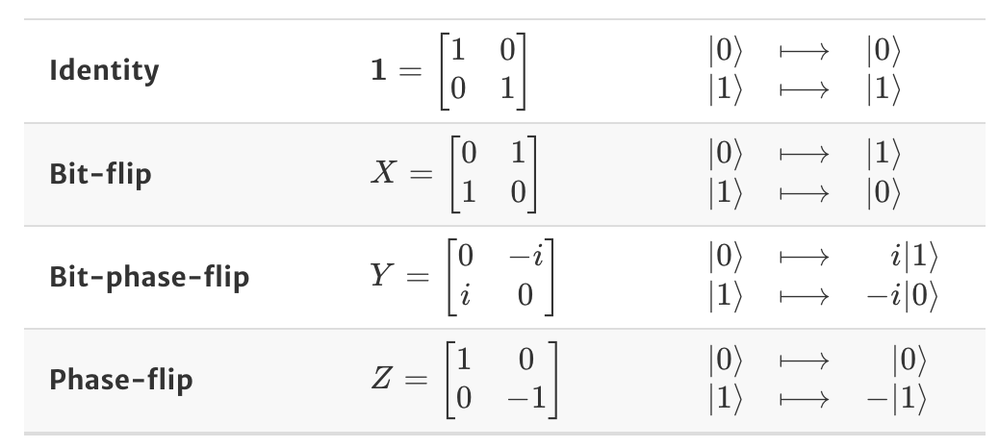
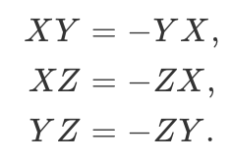
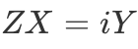


Pauli operators/gates
They do not commute
NOT
gate
They are related

Slide 29



From bit-flits to phase-flips, and back again
by applying the Hadamard gate, we can change Z (X) gate to X (Z) gate
They are useful for quantum error correction

Slide 30


Single-qubit quantum gates
In principle, we may have infinitely number of single-qubit quantum unitary operations
Any unitary operation on a qubit (up to an overall phase) can be implemented by the above circuit, containing two Hadamard gates and three phase gates (with adjustable phase settings)

Slide 31


Quantum dynamics
For time-independent Hamiltonian

Slide 32


Quantum measurement
Quantum measurement is not a passive acquisition of information
If we measure a quantum system, we disturb it.
The sudden change of quantum state, from the pre-measurement state to the post-measurement state, is called a collapse

Slide 33
Quantum entanglement

Slide 34




From one qubit to two
Single qubit basis
The most general state of one qubit
Two qubits basis
The most general state of two qubits (a bipartite state)

Slide 35


Examples of 2-qubit states
Is there any essential difference between them?

Slide 36


Separable vs. Entangled states
Separable if it can be decomposed into a pair of state vectors where each one pertains to one of the two qubits only
Entangled if it does not admit such a decomposition

Slide 37


More qubits
Separable 3-qubit states
Apply the Hadamard gate to the first qubit, it is still separable

Slide 38
Hadamard gate → quantum interference
For single qubit, it does not create entanglement between qubits
Initial state |0>
Amplitude in |0> at the end of the circuit
Hadamard gates
Phase gate

Slide 39

How to create entangled states?
Entanglement is the result of interactions
Applying single-qubit gates to change individual qubits won’t create entanglement

Slide 40

controlled-NOT (c-NOT)
The most popular two-qubit entangling gate
Also known as controlled-X gate
It acts on two qubits: it flips the 2nd qubit (target) if the first qubit (control) is |1>, and does nothing if the control qubit is |0>

Slide 41



C-NOT gate circuit notation
control
target
XOR or addition modulo 2

Slide 42


c-NOT for entanglement generation
Quiz:
Try other examples, for example,
If initial state is
|01> → ?
|10> → ?
|11> → ?
separable
entangled

Slide 43



Bell states generator
Hadamard + c-NOT gates implements the unitary operation which maps the standard computational basis into the four entangled states, known as Bell states
Standard notation for Bell states

Slide 44


Bell states
They form the orthonormal basis in the Hilbert space of two qubits, similar to the original product states basis (computational basis) |00>, |01>, |10>, |11>
One can also perform measurements in the Bell basis
If we reverse the circuit (c-NOT and then Hadamard), it maps the Bell states to the corresponding state |ij> in the computational basis
The Bell states are maximally entangled (their reduced density operators are maximally mixed)

Slide 45

Quantum teleportation
An unknown quantum state can be teleported from one location to another.
A Bell state generator followed by an “offset” inverse Bell state generator

Slide 46


Bell state generator for qubits 2 and 3
After the Bell state generator
It can be re-arranged into another form (for the convenience of applying the following gates)
Quiz:
Check they are equal

Slide 47









Inverse Bell state generator for qubits 1 and 2
The inverse Bell state generator evolves the Bell states (of the first two qubits) back to |ij> in the computational basis

Slide 48



Quantum teleportation
Perform standard measurement of the first 2 qubits, i.e., project it to the computational basis
Depending on the measurement outcomes, we know the third qubit will collapse to different quantum state. Then, we can perform another transformation to the 3rd qubit to obtain original state

Slide 49
Quantum algorithms

Slide 50

Shor’s code for quantum error correction
A specific error correction circuit which can correct both phase flips and bit flip errors
main qubit
8 ancillary qubits to correct 1 qubit

Slide 51

Shor’s factoring algorithm

Slide 52
Question: Quantum gate optimization
A quantum circuit
Depth: 7
Three two-qubit gates
Five single qubit gates
To realize a unitary transformation
How do we find the optimal parameters to realize such an operation with the above circuit?

Slide 53
Introduction to reinforcement learning

Slide 54

What is Reinforcement Learning (RL)?
RL is a type of ML where an agent learns by interacting with an environment
The agent tries actions and receives feedback in the form of rewards or penalties.
The goal is to learn a strategy (policy) that maximizes cumulative rewards (discounted return) over time.
Unlike supervised learning, RL does not rely on labeled data.

Slide 55

Board Game: Go
Objective: Win the board game Go.
State: Position of all pieces
Action: Where to put the next piece
Reward: 1 point if win at the end of the game, 0 otherwise
t

Slide 56

Example: Robot locomotion
Objective: teach the robot to walk forward
State: the current angle and position of the robot’s joints (like knees, hips, etc)
Action: how much force or torque the robot applies to move each joint
Reward: the robot earns 1 point every moment it stays upright and move forward

Slide 57

Example: Atari Games
Objective: teach the agent to play and win the Atari game
State: the current image on the screen (what the agent sees)
Action: Pressing buttons on the controller (or move left, right, jump, or shoot)
Reward: Points scored in the game, for example, hitting a target or collecting a coin gives a positive reward

Slide 58

Agent and Environment
Agent: the decision-maker that learns how to act
Environment: everything the agent interacts with, or the system that the agent tries to control
Super Mario

Slide 59
State, Action, and Reward
State: a representation of the environment at a specific moment
Action: a move or decision the agent makes at a given state
Reward: a numerical signal indicating the success of an action
The agent observes the current state (S_{t}) of the environment and select actions (A_{t})
The environment updates based on the action and returns a new state (S_{t+1}) and reward (R_{t+1})
Rewards are used to guide the agent’s learning: actions that lead to higher rewards are reinforced (strengthened) over time, while less rewarding actions are discouraged

Slide 60

Return and Objective
Return: the total accumulated reward over time
The agent’s goal is to maximize the expected return
Discounted return: future rewards may be worth less than immediate rewards
Objective function: often defined as the expected discounted return

Slide 61


Discount factor ($γ$)
$γ$ is the discount factor in range [0, 1]
It indicates how much the future rewards are “worth” at the current moment (time t)
If $γ$=0, we do not care about future rewards; the return is just the immediate reward → the agent is short-sighted
If $γ$=1, the return is the unweighted sum of all subsequent rewards
Due to inflation, earning a $100 bill right now could be worth more than earning it in the future

